Slide 1
CYBER AWARENESS MONTH · ICS / OT / IoT
Cyber-Physical
“Spot the Issue” Catalog
A field companion to the corporate-office awareness scene — for operational technology.
15 scenarios · 120 flagged findings · IEC 62443-3-3 · IEC 62443-4-2 · Secure PLC Coding Top 20 · ISA-TR84.00.09 v3
Manufacturing
Oil & Gas
Electric
Natural Gas
Maritime
Buildings & Facilities
Cyber, safety & good-practice findings — each flagged to the standard, requirement ID and name.

Slide 2
How to use this catalog
1
Spot the markers
FINDING TYPE
Each scene hides 8 numbered findings. Learners call out what looks wrong at each numbered marker.
Cyber
Safety / cyber-physical
Good practice
STANDARDS FLAGGED
2
Open the answer key
3-3
IEC 62443-3-3 (system security requirements)
The slide that follows each scene lists every finding — what to look for, its type, and the standards it maps to.
4-2
IEC 62443-4-2 (component security requirements)
PLC
Secure PLC Coding Practices – Top 20
3
Run it as a quiz
84.09
ISA-TR84.00.09 v3 (cybersecurity & the functional-safety lifecycle)
Reveal the key one item at a time, or hold it back and let the group find all eight first.
On the standard IDs. 62443-3-3 (SR), 62443-4-2 (CR/EDR/HDR/NDR) and the PLC Top 20 (#) are cited by exact requirement/item ID and name. ISA-TR84.00.09 v3 items are flagged by security-lifecycle element and the IEC 61511 phase (Analysis / Realization / Operation); confirm exact clause numbers against your controlled copy of v3.

Slide 3
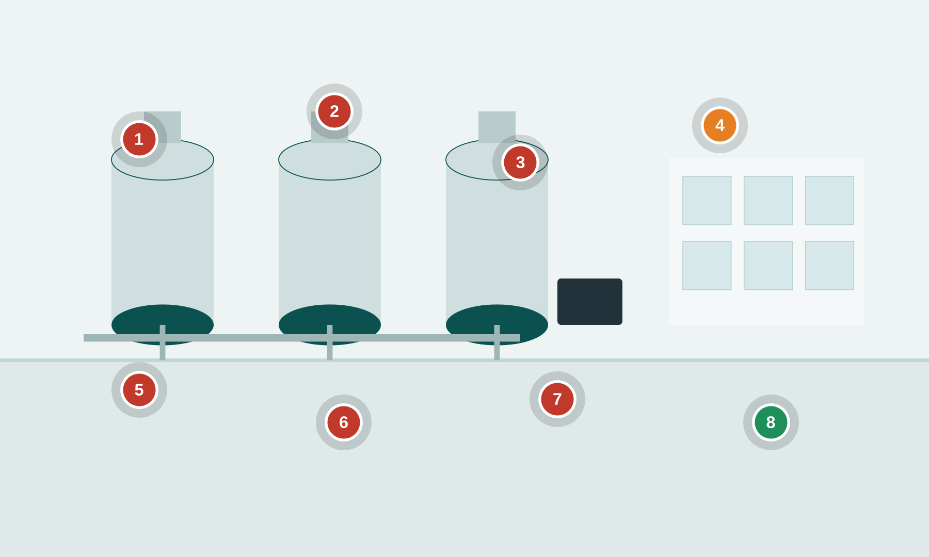
MANUFACTURING
6 cyber
1 safety
1 good
Pharma / Biotech Manufacturing Plant
Bioreactor cleanroom suite — DCS/MES, serialization line, batch records
● cyber ● safety ● good practice Numbered markers = planted findings. Answer key on the next slide.
Notes:
Setting: A GMP bioreactor and cleanroom suite. Operators run a batch from HMIs on a process DCS; an MES pulls recipes and writes electronic batch records; a serialization/packaging line runs downstream; a bioreactor SIS protects against over-pressure and runaway reactions.
Key OT/IoT assets: Bioreactor / fermenter PLCs, Process DCS + operator HMIs, MES & OT historian, Serialization / packaging line PLC, Bioreactor SIS (over-pressure trip), CIP (clean-in-place) skid, Engineering workstation (EWS)
People & roles: Batch/process operator, Manufacturing / automation engineer, QA (batch release), Contract validation engineer, Maintenance technician
Processes: Batch execution & recipe download, Change control / MOC, Data historian & batch review, Cleaning validation (CIP), SIS proof testing

Slide 4
MANUFACTURING
Pharma / Biotech Manufacturing Plant — what to look for
1. Shared HMI login Cyber
3-3 SR 1.1 Human user identification and authentication
4-2 CR 1.1 Human user identification and authentication
84.09 Operation SIS access control and independence from the BPCS
5. Flat MES/OT network Cyber
3-3 SR 5.1 Network segmentation
3-3 SR 5.2 Zone boundary protection
4-2 CR 5.1 Network segmentation
2. Recipe editable at HMI Cyber
3-3 SR 2.1 Authorization enforcement
3-3 SR 3.4 Software and information integrity
PLC #8 Validate HMI input variables at the PLC level, not only at the HMI
6. Default vendor password Cyber
3-3 SR 1.5 Authenticator management
3-3 SR 1.7 Strength of password-based authentication
4-2 CR 1.7 Strength of password-based authentication
3. Laptop + USB on DCS Cyber
3-3 SR 2.3 Use control for portable and mobile devices
4-2 CR 2.13 Use of physical diagnostic and test interfaces
3-3 SR 3.2 Malicious code protection
7. Historian export to USB Cyber
3-3 SR 4.1 Information confidentiality
3-3 SR 5.3 General purpose person-to-person communication restrictions
3-3 SR 2.3 Use control for portable and mobile devices
4. SIS trip bypassed Safety
84.09 Operation Bypass / override management for the SIS
PLC #2 Track operating modes
PLC #15 Define a safe process state in case of a PLC restart
8. Signed serialization code Good practice
PLC #5 Use cryptographic and/or checksum integrity checks for PLC code
3-3 SR 3.4 Software and information integrity

Slide 5

OIL & GAS
5 cyber
2 safety
1 good
Oil & Gas — Upstream Wellpad & Drilling
Remote wellpad — RTU/flow computer, wellhead ESD, drilling rig, cellular SCADA
● cyber ● safety ● good practice Numbered markers = planted findings. Answer key on the next slide.
Notes:
Setting: A remote wellpad with a drilling rig doghouse. A field RTU / flow computer telemeters production over a cellular/satellite link to a central SCADA; the wellhead has an emergency shutdown (ESD) valve; H2S gas detection protects crews.
Key OT/IoT assets: Field RTU / flow computer, Wellhead ESD valve, Drilling rig control (doghouse), Cellular / satellite SCADA modem, H2S gas detection, Custody metering, RTU enclosure / cabinet
People & roles: Pumper / lease operator, Drilling crew (driller, roughnecks), SCADA / automation tech, Third-party service contractor, HSE / safety officer
Processes: Production telemetry & polling, Well control & ESD, Custody transfer measurement, Contractor turnaround work, Gas-detection alarm response

Slide 6
OIL & GAS
Oil & Gas — Upstream Wellpad & Drilling — what to look for
1. RTU exposed to internet Cyber
3-3 SR 1.13 Access via untrusted networks
3-3 SR 5.2 Zone boundary protection
4-2 CR 3.1 Communication integrity
5. Shared creds on sticky note Cyber
3-3 SR 1.5 Authenticator management
3-3 SR 1.7 Strength of password-based authentication
3-3 SR 1.1 Human user identification and authentication
2. ESD in manual bypass Safety
84.09 Operation Bypass / override management for the SIS
PLC #2 Track operating modes
PLC #15 Define a safe process state in case of a PLC restart
6. Open RTU cabinet Cyber
4-2 EDR 3.11 Physical tamper resistance and detection
4-2 CR 2.13 Use of physical diagnostic and test interfaces
3. Plaintext Modbus/SNMP Cyber
3-3 SR 3.1 Communication integrity
3-3 SR 4.3 Use of cryptography
PLC #13 Disable unused / unneeded communication ports and protocols
7. H2S detector disabled Safety
PLC #20 Trap false negatives and false positives for critical alerts
PLC #7 Validate and alert for paired inputs / outputs
3-3 SR 6.2 Continuous monitoring
4. Contractor Wi-Fi laptop Cyber
3-3 SR 2.3 Use control for portable and mobile devices
3-3 SR 1.6 Wireless access management
4-2 NDR 1.6 Wireless access management
8. Signed RTU firmware Good practice
3-3 SR 7.8 Control system component inventory
4-2 EDR 3.10 Support for updates
4-2 EDR 3.14 Integrity of the boot process

Slide 7
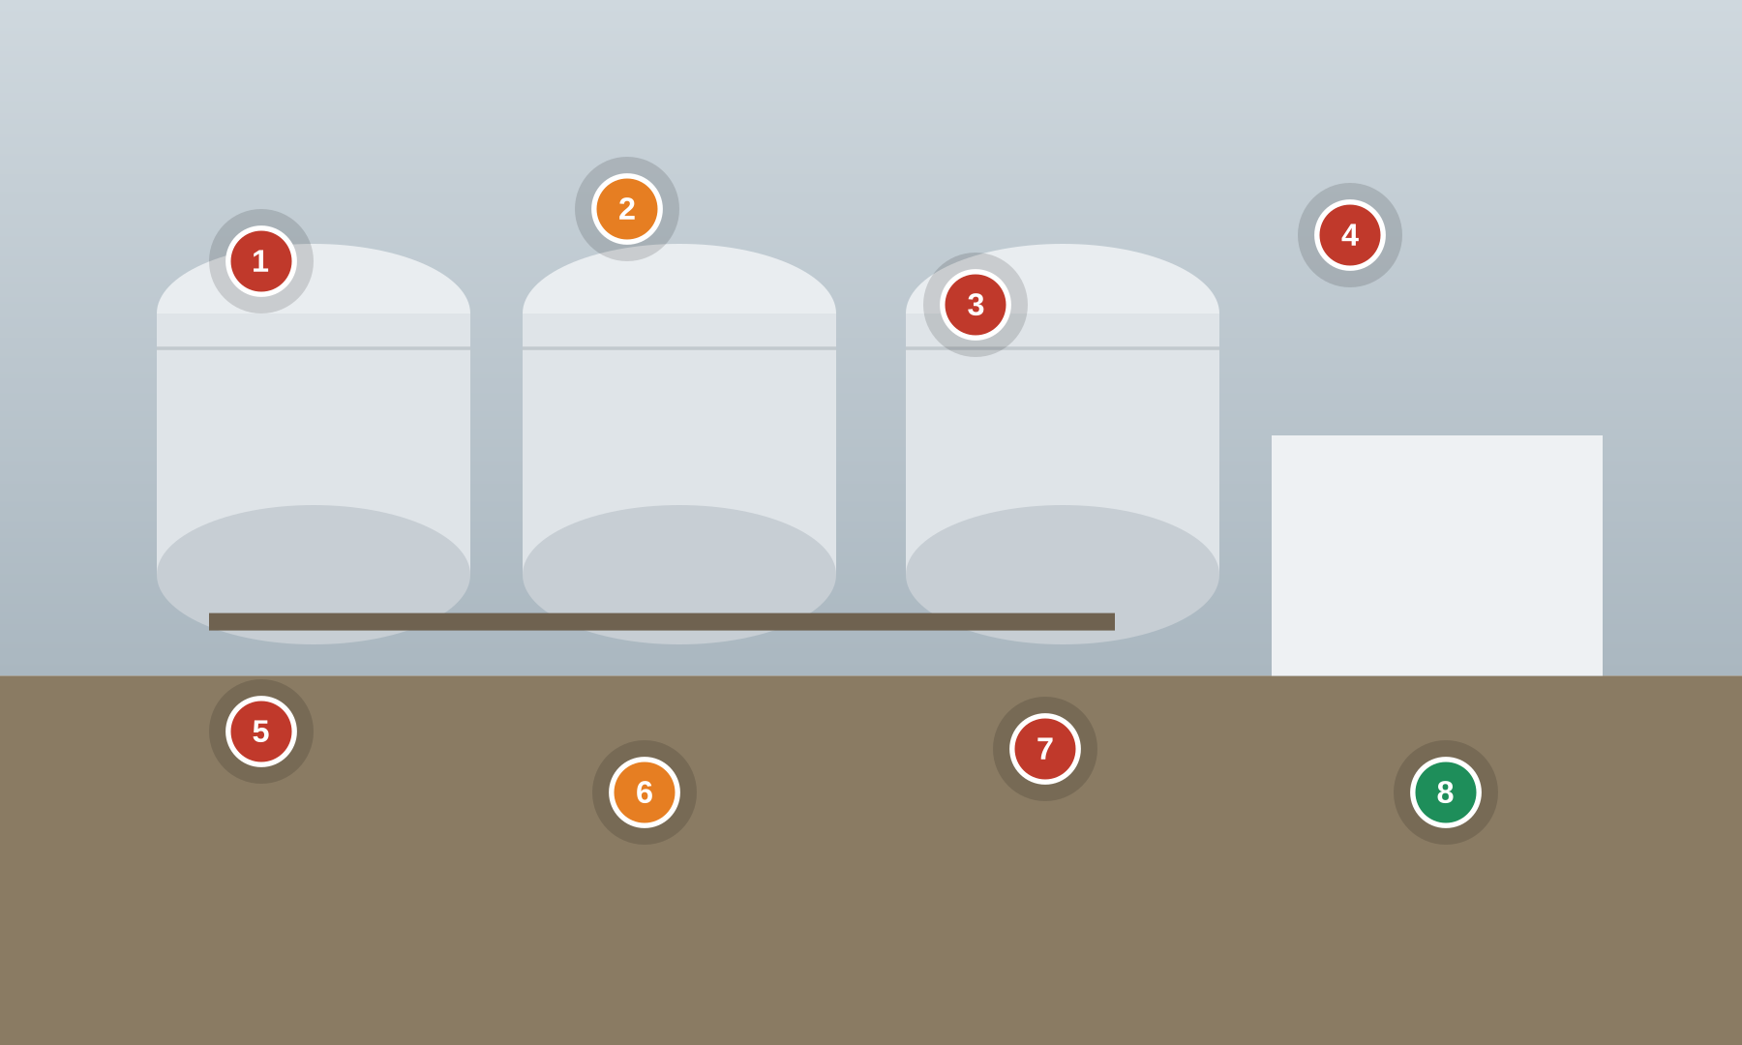
OIL & GAS
5 cyber
2 safety
1 good
Oil & Gas — Midstream Pump Station & Tank Farm
Pipeline pump station — SCADA, mainline pumps, custody metering, tank overfill SIS
● cyber ● safety ● good practice Numbered markers = planted findings. Answer key on the next slide.
Notes:
Setting: A crude pipeline pump station and tank farm. SCADA drives mainline pump VFDs; custody metering measures transfers; storage tanks are protected by an overfill-prevention SIS and high-high level alarms; a leak-detection system watches the line.
Key OT/IoT assets: Pipeline SCADA + HMI server, Mainline pump VFD PLCs, Custody metering flow computers, Tank overfill SIS + high-high level, Leak-detection system, SCADA historian
People & roles: Pipeline controller (control center), Station operator, Measurement technician, SCADA engineer, Vendor remote support
Processes: Pipeline batching & pump control, Tank gauging & overfill protection, Custody transfer measurement, Leak detection & response, Remote vendor support

Slide 8
OIL & GAS
Oil & Gas — Midstream Pump Station & Tank Farm — what to look for
1. Remote access open to internet Cyber
3-3 SR 1.13 Access via untrusted networks
3-3 SR 2.6 Remote session termination
3-3 SR 5.2 Zone boundary protection
5. Weak SCADA credentials Cyber
3-3 SR 1.1 Human user identification and authentication
3-3 SR 1.7 Strength of password-based authentication
3-3 SR 1.5 Authenticator management
2. Tank overfill trip inhibited Safety
84.09 Operation Bypass / override management for the SIS
PLC #7 Validate and alert for paired inputs / outputs
PLC #12 Validate inputs based on physical plausibility
6. Leak detection muted Safety
PLC #2 Track operating modes
PLC #20 Trap false negatives and false positives for critical alerts
3-3 SR 6.2 Continuous monitoring
3. Writable custody metering Cyber
3-3 SR 3.1 Communication integrity
3-3 SR 3.5 Input validation
PLC #14 Restrict third-party data interfaces
7. Unpatched SCADA server Cyber
3-3 SR 3.2 Malicious code protection
3-3 SR 7.6 Network and security configuration settings
4-2 HDR 3.2 Malicious code protection
4. Flat pump network Cyber
3-3 SR 5.1 Network segmentation
3-3 SR 5.2 Zone boundary protection
4-2 CR 5.1 Network segmentation
8. DMZ + one-way historian Good practice
3-3 SR 5.2 Zone boundary protection
3-3 SR 5.1 Network segmentation
3-3 SR 6.1 Audit log accessibility

Slide 9
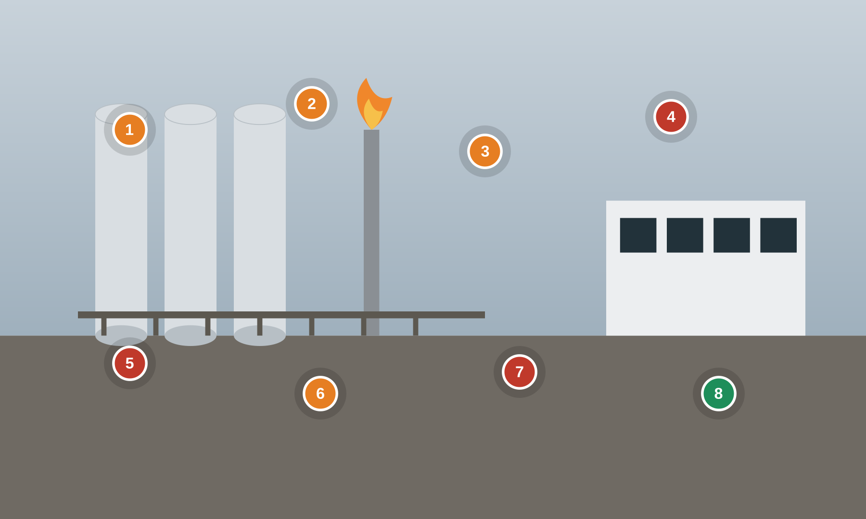
OIL & GAS
3 cyber
4 safety
1 good
Oil & Gas — Downstream Refinery & Control Room
Refinery process unit — DCS control room, BPCS/SIS separation, furnace & flare
● cyber ● safety ● good practice Numbered markers = planted findings. Answer key on the next slide.
Notes:
Setting: A refinery process unit run from a central control room. A DCS (BPCS) drives the process; an independent SIS provides trips for furnaces, columns and compressors; operators work consoles under alarm management; vendors provide remote support.
Key OT/IoT assets: DCS / BPCS + operator consoles, Independent SIS + logic solver, SIS engineering workstation, Furnace / heater trips, Flare & relief system, Alarm management system
People & roles: Board operator, Outside operator, Process control engineer, Functional safety engineer, DCS/SIS vendor (remote)
Processes: Process control (BPCS), Safety instrumented functions (SIS), Alarm management & rationalization, Management of change, Vendor remote support

Slide 10
OIL & GAS
Oil & Gas — Downstream Refinery & Control Room — what to look for
1. BPCS & SIS not separated Safety
84.09 Realization SIS zones and conduits (SIS as a separate zone)
3-3 SR 5.1 Network segmentation
3-3 SR 5.4 Application partitioning
5. Always-on vendor VPN Cyber
3-3 SR 1.13 Access via untrusted networks
3-3 SR 2.6 Remote session termination
4-2 NDR 5.2 Zone boundary protection
2. SIS key-switch in PROGRAM Safety
PLC #2 Track operating modes
84.09 Realization Security verification & validation of the SIF
4-2 CR 2.13 Use of physical diagnostic and test interfaces
6. Alarm flood / shelved alarms Safety
PLC #20 Trap false negatives and false positives for critical alerts
3-3 SR 6.2 Continuous monitoring
84.09 Operation Management of change (MOC) for SIS security
3. Furnace trip forced Safety
84.09 Operation Bypass / override management for the SIS
PLC #15 Define a safe process state in case of a PLC restart
3-3 SR 2.1 Authorization enforcement
7. USB IT->DCS transfer Cyber
3-3 SR 2.3 Use control for portable and mobile devices
3-3 SR 3.2 Malicious code protection
3-3 SR 3.4 Software and information integrity
4. Unlocked shared console Cyber
3-3 SR 2.5 Session lock
3-3 SR 1.1 Human user identification and authentication
4-2 CR 2.5 Session lock
8. Independent, locked SIS Good practice
84.09 Operation Management of change (MOC) for SIS security
3-3 SR 7.6 Network and security configuration settings
4-2 EDR 3.11 Physical tamper resistance and detection

Slide 11
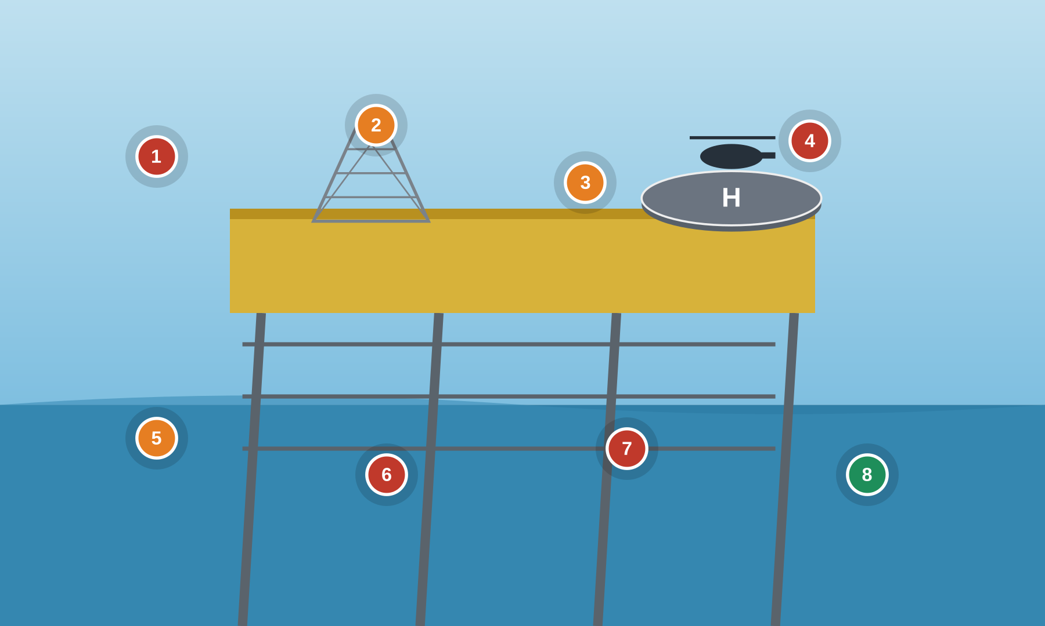
OIL & GAS
4 cyber
3 safety
1 good
Oil & Gas — Offshore Platform & Helicopter Transfer
Offshore production — ICSS, Fire & Gas, ESD, helideck, VSAT, crew change
● cyber ● safety ● good practice Numbered markers = planted findings. Answer key on the next slide.
Notes:
Setting: An offshore production platform. An Integrated Control & Safety System (ICSS) runs process, Fire & Gas (F&G) and Emergency Shutdown (ESD). A helideck supports crew change and refuelling; a VSAT link connects to shore; wireless IIoT sensors monitor equipment.
Key OT/IoT assets: Integrated Control & Safety System (ICSS), Fire & Gas (F&G) system, ESD valves & logic, Helideck control & refuelling PLC, VSAT / satellite link, Wireless IIoT sensors
People & roles: Offshore Installation Manager (OIM), Control-room operator, Instrument/automation tech, Turnaround contractor, Helicopter crew / HLO
Processes: Production control (ICSS), Fire & Gas detection, Emergency shutdown, Helideck ops & refuelling, Crew change / turnaround

Slide 12
OIL & GAS
Oil & Gas — Offshore Platform & Helicopter Transfer — what to look for
1. VSAT flat to shore Cyber
3-3 SR 5.2 Zone boundary protection
3-3 SR 1.13 Access via untrusted networks
4-2 NDR 5.2 Zone boundary protection
5. ESD override no confirm Safety
84.09 Operation Management of change (MOC) for SIS security
PLC #2 Track operating modes
3-3 SR 2.1 Authorization enforcement
2. F&G inhibited Safety
PLC #7 Validate and alert for paired inputs / outputs
PLC #20 Trap false negatives and false positives for critical alerts
84.09 Operation Bypass / override management for the SIS
6. Shared OIM account Cyber
3-3 SR 1.1 Human user identification and authentication
3-3 SR 1.3 Account management
3-3 SR 1.5 Authenticator management
3. Helideck PLC on process net Safety
3-3 SR 5.1 Network segmentation
3-3 SR 5.4 Application partitioning
PLC #13 Disable unused / unneeded communication ports and protocols
7. Open wireless IIoT Cyber
3-3 SR 1.6 Wireless access management
3-3 SR 2.2 Wireless use control
3-3 SR 4.3 Use of cryptography
4. Crew-change laptop/USB Cyber
3-3 SR 2.3 Use control for portable and mobile devices
3-3 SR 3.2 Malicious code protection
4-2 CR 2.13 Use of physical diagnostic and test interfaces
8. Defined safe state + recovery Good practice
PLC #15 Define a safe process state in case of a PLC restart
3-3 SR 7.4 Control system recovery and reconstitution
3-3 SR 7.5 Emergency power

Slide 13
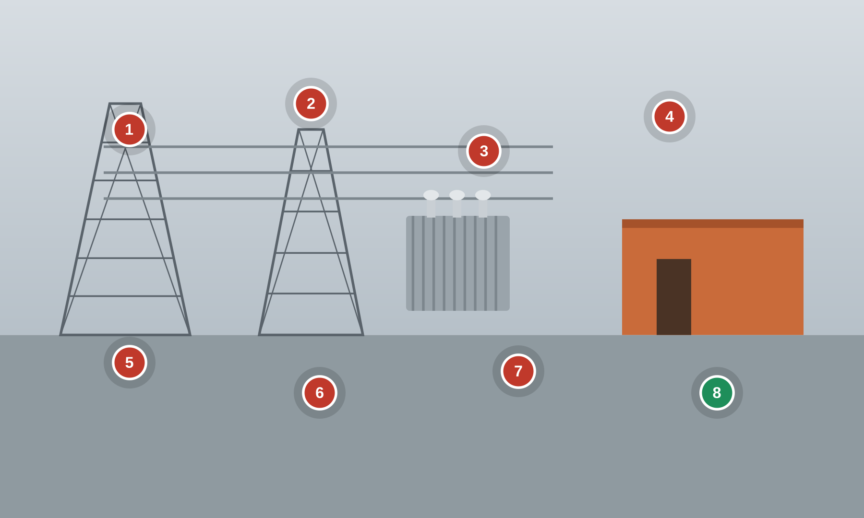
ELECTRIC
7 cyber
0 safety
1 good
Electric — Transmission Substation
HV substation — RTU, protective relays (IEC 61850), GOOSE, control house
● cyber ● safety ● good practice Numbered markers = planted findings. Answer key on the next slide.
Notes:
Setting: A high-voltage transmission substation. Protective relays (IEDs) trip breakers over an IEC 61850 station bus (GOOSE/SV); a substation RTU/gateway telemeters to the SCADA/EMS; a control house holds relay panels and the station HMI.
Key OT/IoT assets: Protective relays / IEDs, Substation RTU / gateway, IEC 61850 station bus (GOOSE/SV), Station HMI, Power transformers & breakers, Managed station switches
People & roles: System operator (control center), Protection & control engineer, Substation technician, Relay test contractor, Physical security / access
Processes: Protection & tripping, Remote SCADA/EMS telemetry, Relay setting changes, Firmware maintenance, Physical access control

Slide 14
ELECTRIC
Electric — Transmission Substation — what to look for
1. Unauthenticated IEC 61850 Cyber
3-3 SR 1.2 Software process and device identification and authentication
3-3 SR 3.1 Communication integrity
4-2 CR 1.2 Software process and device identification and authentication
5. Control house unsecured Cyber
4-2 EDR 3.11 Physical tamper resistance and detection
4-2 CR 2.13 Use of physical diagnostic and test interfaces
3-3 SR 2.1 Authorization enforcement
2. Dial-in default password Cyber
3-3 SR 1.13 Access via untrusted networks
3-3 SR 1.5 Authenticator management
3-3 SR 1.7 Strength of password-based authentication
6. GOOSE not monitored Cyber
3-3 SR 6.2 Continuous monitoring
3-3 SR 3.1 Communication integrity
3-3 SR 5.1 Network segmentation
3. Laptop bridges IT/OT Cyber
3-3 SR 5.1 Network segmentation
3-3 SR 5.2 Zone boundary protection
4-2 CR 5.1 Network segmentation
7. Unpatched IED firmware Cyber
4-2 EDR 3.10 Support for updates
4-2 EDR 3.14 Integrity of the boot process
3-3 SR 7.8 Control system component inventory
4. Relay change, no approval/audit Cyber
3-3 SR 2.1 Authorization enforcement
3-3 SR 2.8 Auditable events
3-3 SR 2.12 Non-repudiation
8. Segmented bus + SIEM Good practice
4-2 NDR 5.2 Zone boundary protection
3-3 SR 6.1 Audit log accessibility
3-3 SR 5.1 Network segmentation

Slide 15
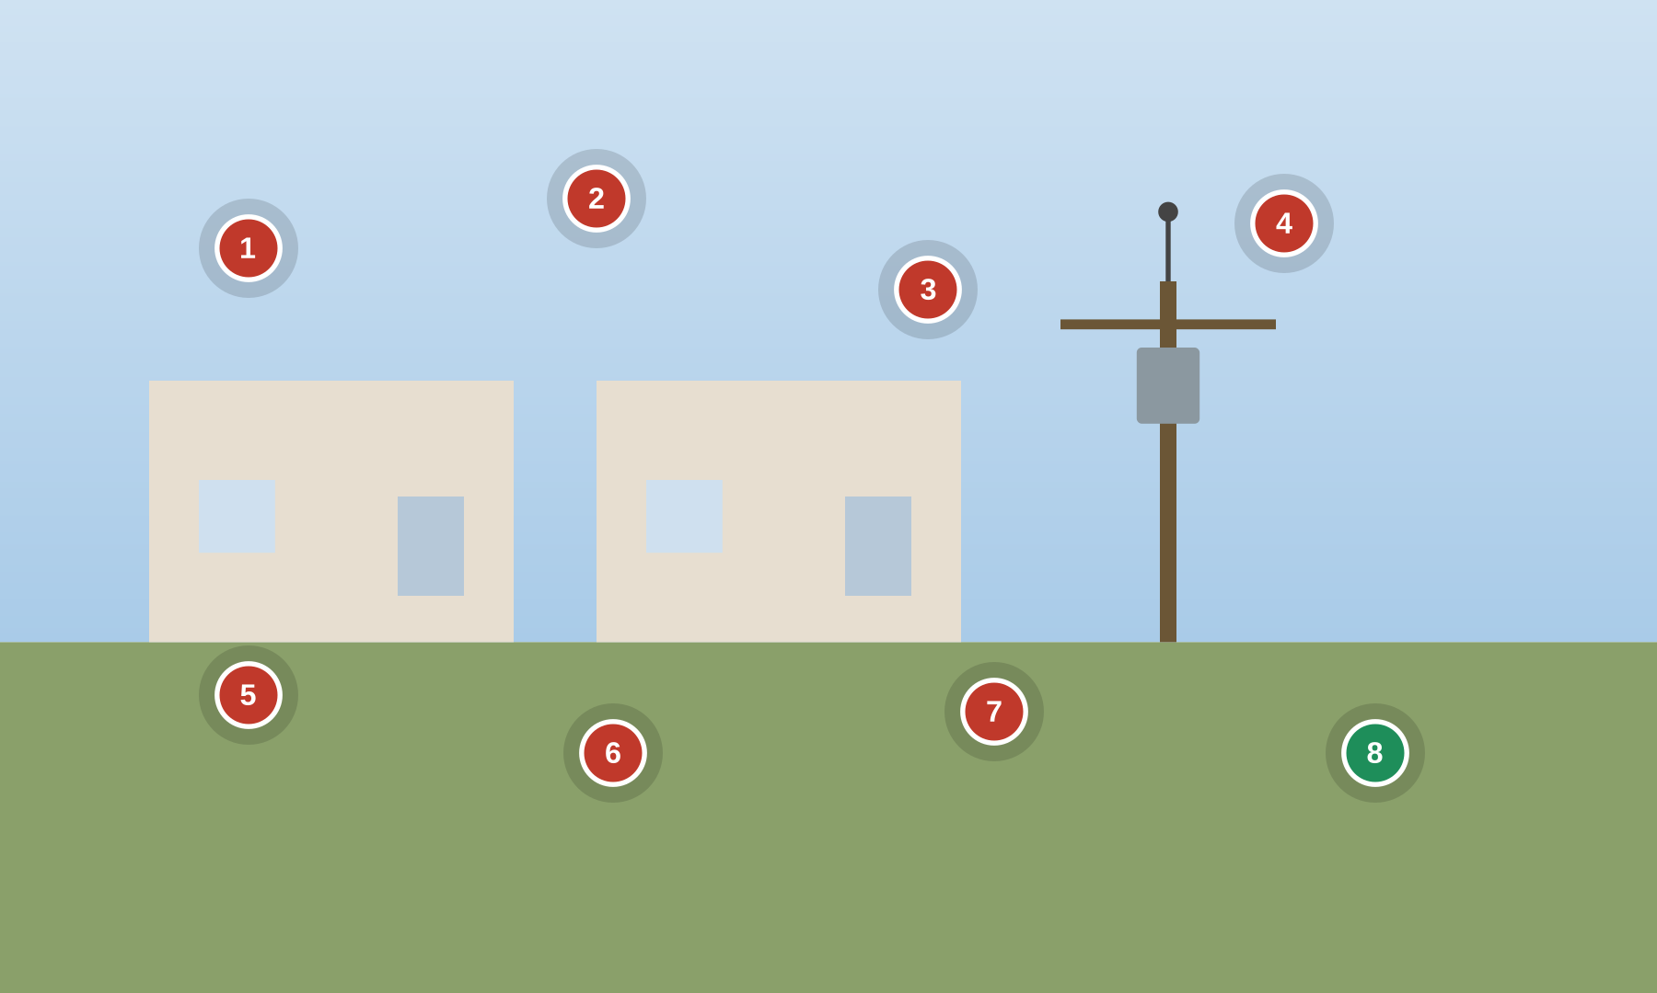
ELECTRIC
7 cyber
0 safety
1 good
Electric — Smart Meters & Distribution Automation
AMI on homes & buildings — smart meters, RF mesh, head-end, reclosers, HAN
● cyber ● safety ● good practice Numbered markers = planted findings. Answer key on the next slide.
Notes:
Setting: Smart meters on homes and buildings report over an RF mesh to collectors and an AMI head-end; distribution automation (reclosers, capacitor banks) is controlled in the field; home-area-network (HAN) gateways connect to meters.
Key OT/IoT assets: Residential/commercial smart meters, RF mesh + data collectors, AMI head-end system, Distribution automation (reclosers), Home-area network (HAN) gateway, Meter disconnect switch
People & roles: Distribution operator, AMI / metering engineer, Field service technician, Utility customer, Meter data management (MDM) team
Processes: Meter reading & billing, Remote connect / disconnect, Firmware management (fleet), Distribution automation control, Tamper / outage detection

Slide 16
ELECTRIC
Electric — Smart Meters & Distribution Automation — what to look for
1. Broken meter seal / local port Cyber
4-2 EDR 3.11 Physical tamper resistance and detection
4-2 CR 2.13 Use of physical diagnostic and test interfaces
3-3 SR 3.4 Software and information integrity
5. Plaintext DNP3 recloser Cyber
3-3 SR 3.1 Communication integrity
3-3 SR 4.3 Use of cryptography
PLC #13 Disable unused / unneeded communication ports and protocols
2. Default RF-mesh keys Cyber
3-3 SR 1.6 Wireless access management
3-3 SR 4.3 Use of cryptography
4-2 NDR 1.6 Wireless access management
6. HAN bridged to meter Cyber
3-3 SR 5.1 Network segmentation
3-3 SR 5.3 General purpose person-to-person communication restrictions
3-3 SR 4.1 Information confidentiality
3. Unsigned firmware push Cyber
3-3 SR 3.4 Software and information integrity
4-2 EDR 3.14 Integrity of the boot process
4-2 EDR 3.10 Support for updates
7. No fleet inventory Cyber
3-3 SR 7.8 Control system component inventory
3-3 SR 6.2 Continuous monitoring
4-2 EDR 3.10 Support for updates
4. Disconnect not authz-controlled Cyber
3-3 SR 2.1 Authorization enforcement
3-3 SR 1.2 Software process and device identification and authentication
3-3 SR 3.5 Input validation
8. Signed FW + per-device keys Good practice
4-2 EDR 3.12 Provisioning product supplier roots of trust
4-2 EDR 3.13 Provisioning asset owner roots of trust
3-3 SR 1.2 Software process and device identification and authentication

Slide 17

NATURAL GAS
5 cyber
2 safety
1 good
Natural Gas — Farm Tap, Pipeline Station & Compression
Gas gathering — farm-tap RTU, metering, compressor ESD, odorizer, telemetry
● cyber ● safety ● good practice Numbered markers = planted findings. Answer key on the next slide.
Notes:
Setting: A natural-gas gathering system runs through farmland: a farm-tap RTU and roadside pipeline metering station telemeter over radio/cellular; a compressor station moves gas with ESD and high-pressure trips; an odorizer injects mercaptan for public safety.
Key OT/IoT assets: Farm-tap RTU / cabinet, Pipeline metering PLC, Compressor station PLC + VFD, ESD & high-pressure trip, Odorizer / injection system, SCADA telemetry radio
People & roles: Gas controller (control center), Measurement / metering tech, Compressor-station operator, Landowner / farmer (adjacent), Vendor remote support
Processes: Gas gathering & telemetry, Custody metering, Compression & pressure control, Odorization (public safety), Remote vendor support

Slide 18
NATURAL GAS
Natural Gas — Farm Tap, Pipeline Station & Compression — what to look for
1. Open farm-tap RTU + radio Cyber
4-2 EDR 3.11 Physical tamper resistance and detection
3-3 SR 1.6 Wireless access management
3-3 SR 4.3 Use of cryptography
5. Always-on vendor cellular Cyber
3-3 SR 1.13 Access via untrusted networks
3-3 SR 1.5 Authenticator management
3-3 SR 2.6 Remote session termination
2. Compressor ESD bypassed Safety
84.09 Operation Bypass / override management for the SIS
PLC #15 Define a safe process state in case of a PLC restart
PLC #2 Track operating modes
6. Odorizer alarm inhibited Safety
PLC #20 Trap false negatives and false positives for critical alerts
PLC #12 Validate inputs based on physical plausibility
3-3 SR 6.2 Continuous monitoring
3. Writable metering PLC Cyber
3-3 SR 3.1 Communication integrity
3-3 SR 3.5 Input validation
PLC #8 Validate HMI input variables at the PLC level, not only at the HMI
7. Unauthenticated polling Cyber
3-3 SR 1.2 Software process and device identification and authentication
3-3 SR 3.1 Communication integrity
4-2 CR 1.2 Software process and device identification and authentication
4. Flat station network Cyber
3-3 SR 5.1 Network segmentation
3-3 SR 5.2 Zone boundary protection
4-2 CR 5.1 Network segmentation
8. Hardened field RTUs Good practice
PLC #13 Disable unused / unneeded communication ports and protocols
3-3 SR 7.6 Network and security configuration settings
3-3 SR 7.7 Least functionality

Slide 19
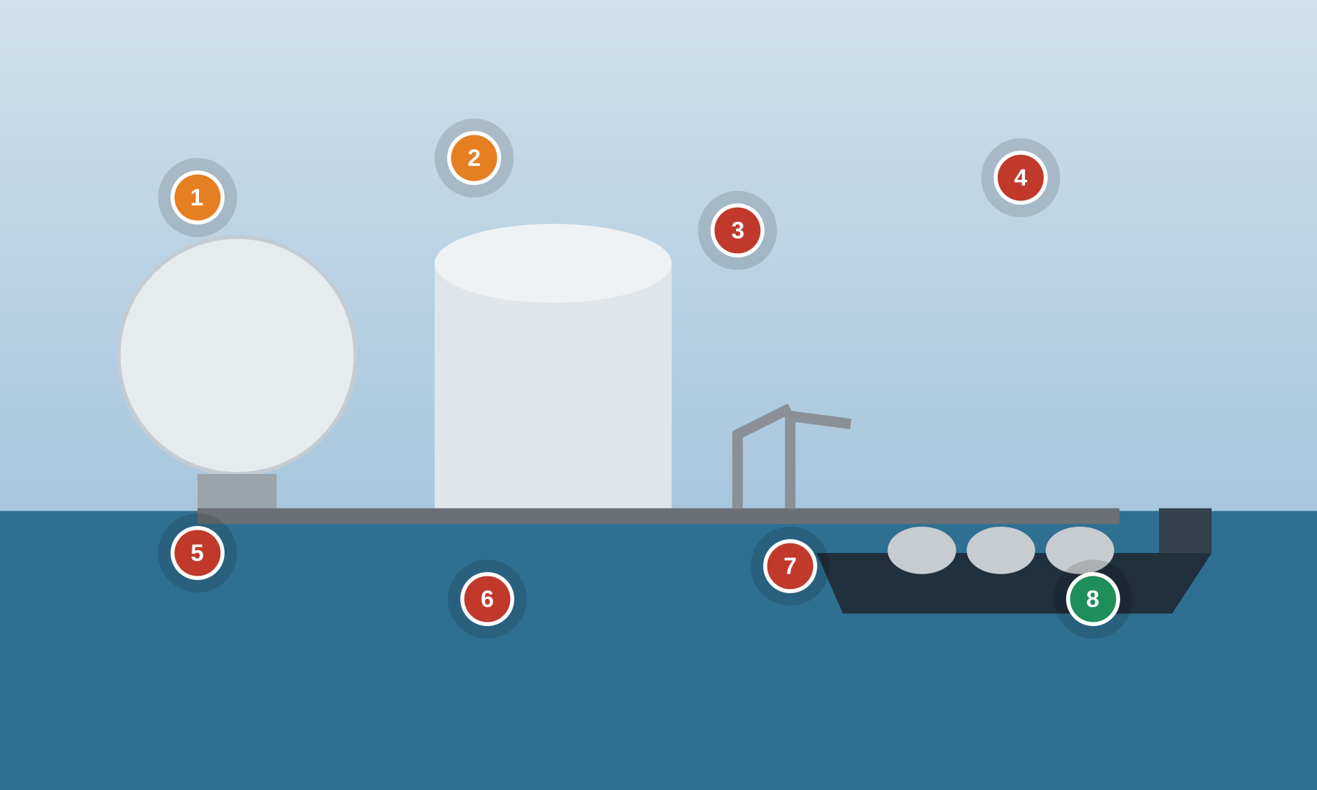
NATURAL GAS
5 cyber
2 safety
1 good
Natural Gas — LNG Terminal
LNG liquefaction/regas — jetty loading arms, ship-shore link, SIS, F&G
● cyber ● safety ● good practice Numbered markers = planted findings. Answer key on the next slide.
Notes:
Setting: An LNG terminal liquefies or regasifies gas and loads/unloads LNG carriers at a jetty. A DCS runs process; an independent SIS and Fire & Gas protect against release; loading arms and a ship-shore link (SSL) manage transfer; mooring/berth monitoring uses IIoT.
Key OT/IoT assets: LNG process DCS, Independent SIS + HIPPS, Fire & Gas (F&G) system, Jetty loading arms + ESD, Ship-shore link (SSL), Berth / mooring IIoT monitoring
People & roles: Terminal control operator, Jetty / marine loading master, Functional safety engineer, LNG carrier crew, DCS/SIS vendor (remote)
Processes: Liquefaction / regasification, Ship loading / unloading (custody), Emergency shutdown (ESD/ESD-2), Fire & Gas detection, Mooring & berth monitoring

Slide 20
NATURAL GAS
Natural Gas — LNG Terminal — what to look for
1. Jetty ESD not independent Safety
84.09 Realization SIS zones and conduits (SIS as a separate zone)
3-3 SR 5.4 Application partitioning
3-3 SR 5.1 Network segmentation
5. Open mooring IIoT Cyber
3-3 SR 1.6 Wireless access management
3-3 SR 4.3 Use of cryptography
4-2 NDR 1.6 Wireless access management
2. F&G forced from commissioning Safety
84.09 Operation Management of change (MOC) for SIS security
PLC #7 Validate and alert for paired inputs / outputs
PLC #15 Define a safe process state in case of a PLC restart
6. Always-on refrigeration VPN Cyber
3-3 SR 1.13 Access via untrusted networks
3-3 SR 2.6 Remote session termination
3-3 SR 6.2 Continuous monitoring
3. Unauthenticated ship-shore link Cyber
3-3 SR 3.1 Communication integrity
3-3 SR 1.2 Software process and device identification and authentication
3-3 SR 4.3 Use of cryptography
7. Shared console, no lock Cyber
3-3 SR 1.1 Human user identification and authentication
3-3 SR 2.5 Session lock
3-3 SR 1.5 Authenticator management
4. DCS laptop shared w/ email Cyber
3-3 SR 2.3 Use control for portable and mobile devices
3-3 SR 5.1 Network segmentation
3-3 SR 3.2 Malicious code protection
8. Independent HIPPS/SIS, MOC Good practice
84.09 Operation Management of change (MOC) for SIS security
3-3 SR 7.6 Network and security configuration settings
4-2 EDR 3.11 Physical tamper resistance and detection

Slide 21
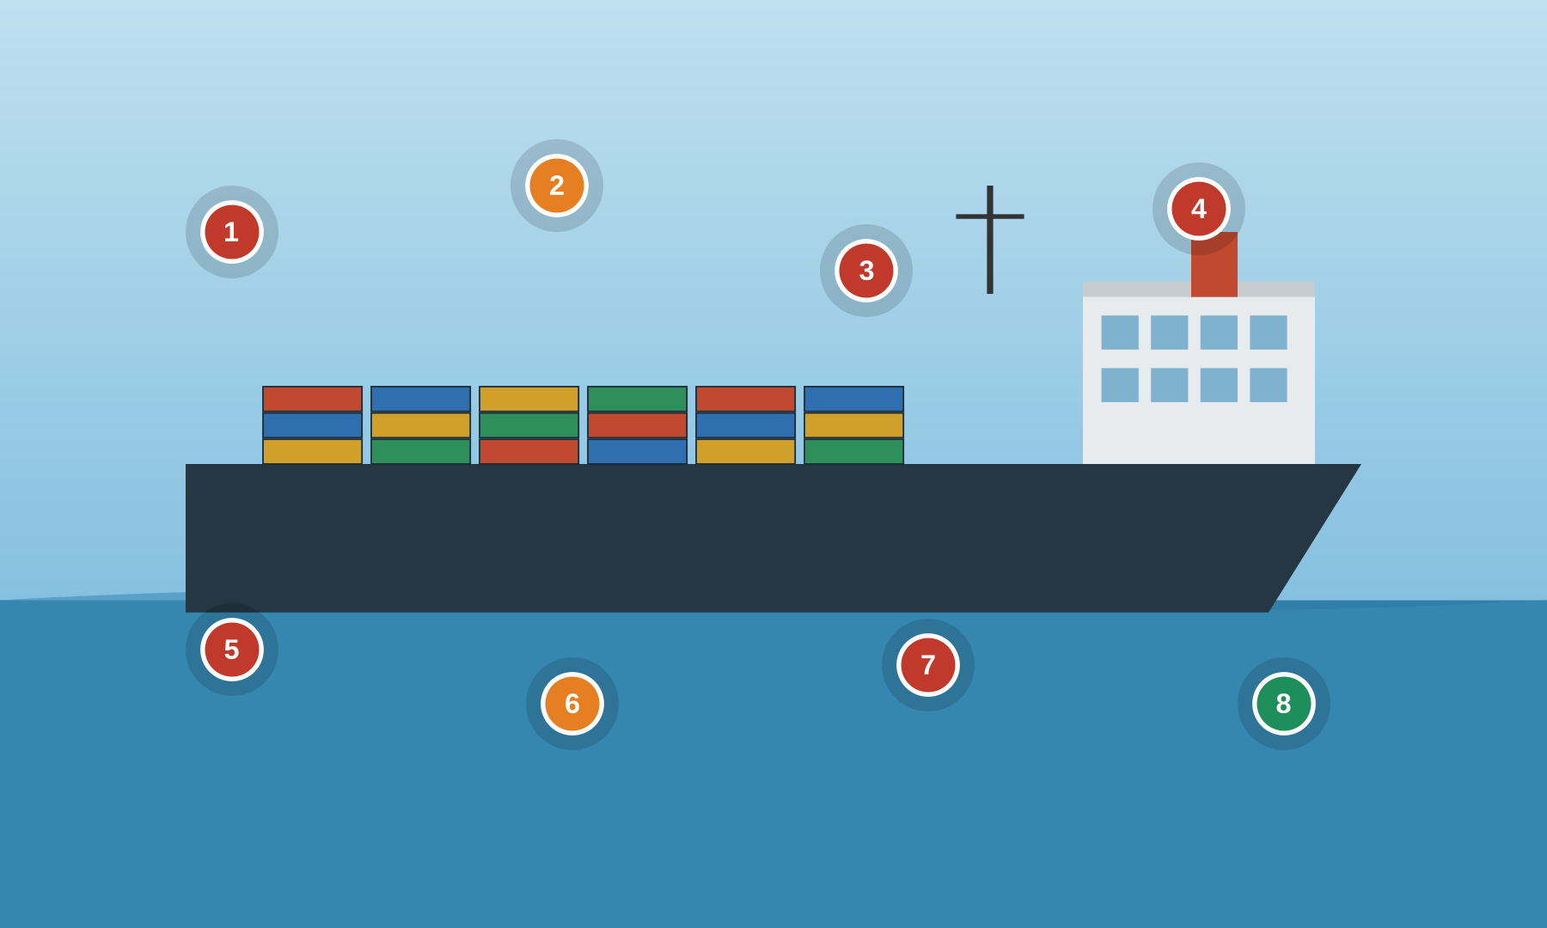
MARITIME
5 cyber
2 safety
1 good
Maritime — Vessel Bridge & Engine Room
Ship OT — ECDIS, IBS, GNSS, engine/propulsion PLC (PMS), VSAT
● cyber ● safety ● good practice Numbered markers = planted findings. Answer key on the next slide.
Notes:
Setting: A vessel's bridge runs an Integrated Bridge System (IBS) with ECDIS and radar fed by GNSS/GPS; the engine room runs an Integrated Automation System (IAS) / Power Management System and propulsion PLCs; VSAT and crew Wi-Fi connect the ship.
Key OT/IoT assets: ECDIS + radar (IBS), GNSS / GPS receiver, Engine / propulsion PLC (PMS), Integrated Automation System (IAS), VSAT + crew Wi-Fi, Serial-to-IP OT gateways
People & roles: Master / OOW (officer of the watch), Chief engineer, Electro-technical officer (ETO), Crew (personal devices), OEM remote support
Processes: Navigation (ECDIS/IBS), Propulsion & power management, Chart & software updates, Ballast / steering control, OEM remote support

Slide 22
MARITIME
Maritime — Vessel Bridge & Engine Room — what to look for
1. ECDIS USB updates Cyber
3-3 SR 2.3 Use control for portable and mobile devices
3-3 SR 3.2 Malicious code protection
4-2 CR 2.13 Use of physical diagnostic and test interfaces
5. Shared bridge login Cyber
3-3 SR 1.1 Human user identification and authentication
3-3 SR 1.3 Account management
3-3 SR 1.5 Authenticator management
2. No GNSS spoof detection Safety
3-3 SR 3.5 Input validation
PLC #12 Validate inputs based on physical plausibility
3-3 SR 6.2 Continuous monitoring
6. Steering safe-state undefined Safety
PLC #15 Define a safe process state in case of a PLC restart
PLC #2 Track operating modes
PLC #20 Trap false negatives and false positives for critical alerts
3. Crew Wi-Fi bridged to nav Cyber
3-3 SR 5.1 Network segmentation
3-3 SR 5.2 Zone boundary protection
4-2 NDR 5.2 Zone boundary protection
7. Default gateway creds Cyber
3-3 SR 1.5 Authenticator management
3-3 SR 1.7 Strength of password-based authentication
PLC #13 Disable unused / unneeded communication ports and protocols
4. Always-on OEM satellite access Cyber
3-3 SR 1.13 Access via untrusted networks
3-3 SR 2.6 Remote session termination
3-3 SR 6.2 Continuous monitoring
8. Segmented per IACS E26/E27 Good practice
3-3 SR 5.1 Network segmentation
3-3 SR 7.8 Control system component inventory
4-2 EDR 3.14 Integrity of the boot process

Slide 23
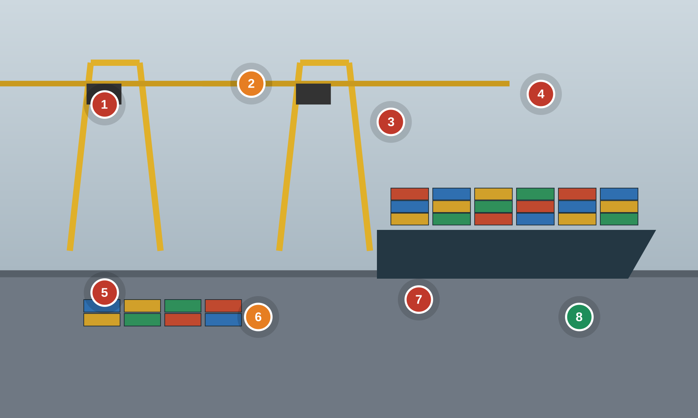
MARITIME
5 cyber
2 safety
1 good
Maritime — Port & Container Terminal
Container terminal — STS/RTG cranes, TOS, reefers, gate OCR, radio remote control
● cyber ● safety ● good practice Numbered markers = planted findings. Answer key on the next slide.
Notes:
Setting: A container terminal moves boxes with ship-to-shore (STS) and yard (RTG/RMG) cranes driven by PLCs; a Terminal Operating System (TOS) coordinates moves; reefer racks, gate OCR and radio remote-control of cranes add IoT/OT exposure.
Key OT/IoT assets: STS ship-to-shore crane PLC/drives, RTG/RMG yard crane PLC, Terminal Operating System (TOS), Reefer monitoring / gate OCR (IoT), Crane radio remote control, Anti-collision / load-moment interlocks
People & roles: Terminal operations controller, Crane operator / driver, Crane maintenance technician, OEM crane support (remote), Gate / yard staff
Processes: Container handling (crane control), Terminal operations (TOS), Crane maintenance & programming, Reefer / gate monitoring, Radio remote crane control

Slide 24
MARITIME
Maritime — Port & Container Terminal — what to look for
1. Crane drive default creds/Wi-Fi Cyber
3-3 SR 1.6 Wireless access management
3-3 SR 1.13 Access via untrusted networks
3-3 SR 1.5 Authenticator management
5. USB crane programming Cyber
3-3 SR 2.3 Use control for portable and mobile devices
3-3 SR 3.4 Software and information integrity
4-2 CR 2.13 Use of physical diagnostic and test interfaces
2. Anti-collision bypassed Safety
84.09 Operation Bypass / override management for the SIS
PLC #7 Validate and alert for paired inputs / outputs
PLC #15 Define a safe process state in case of a PLC restart
6. Unauthenticated radio control Safety
3-3 SR 1.6 Wireless access management
3-3 SR 2.2 Wireless use control
3-3 SR 4.3 Use of cryptography
3. TOS flat to crane OT Cyber
3-3 SR 5.1 Network segmentation
3-3 SR 5.2 Zone boundary protection
4-2 CR 5.1 Network segmentation
7. No PLC change logging Cyber
3-3 SR 2.8 Auditable events
3-3 SR 6.2 Continuous monitoring
3-3 SR 2.12 Non-repudiation
4. Internet-exposed gate/reefer IoT Cyber
3-3 SR 1.5 Authenticator management
3-3 SR 5.2 Zone boundary protection
3-3 SR 1.13 Access via untrusted networks
8. Segmented crane zone + baselines Good practice
4-2 NDR 5.2 Zone boundary protection
3-3 SR 2.8 Auditable events
PLC #5 Use cryptographic and/or checksum integrity checks for PLC code

Slide 25
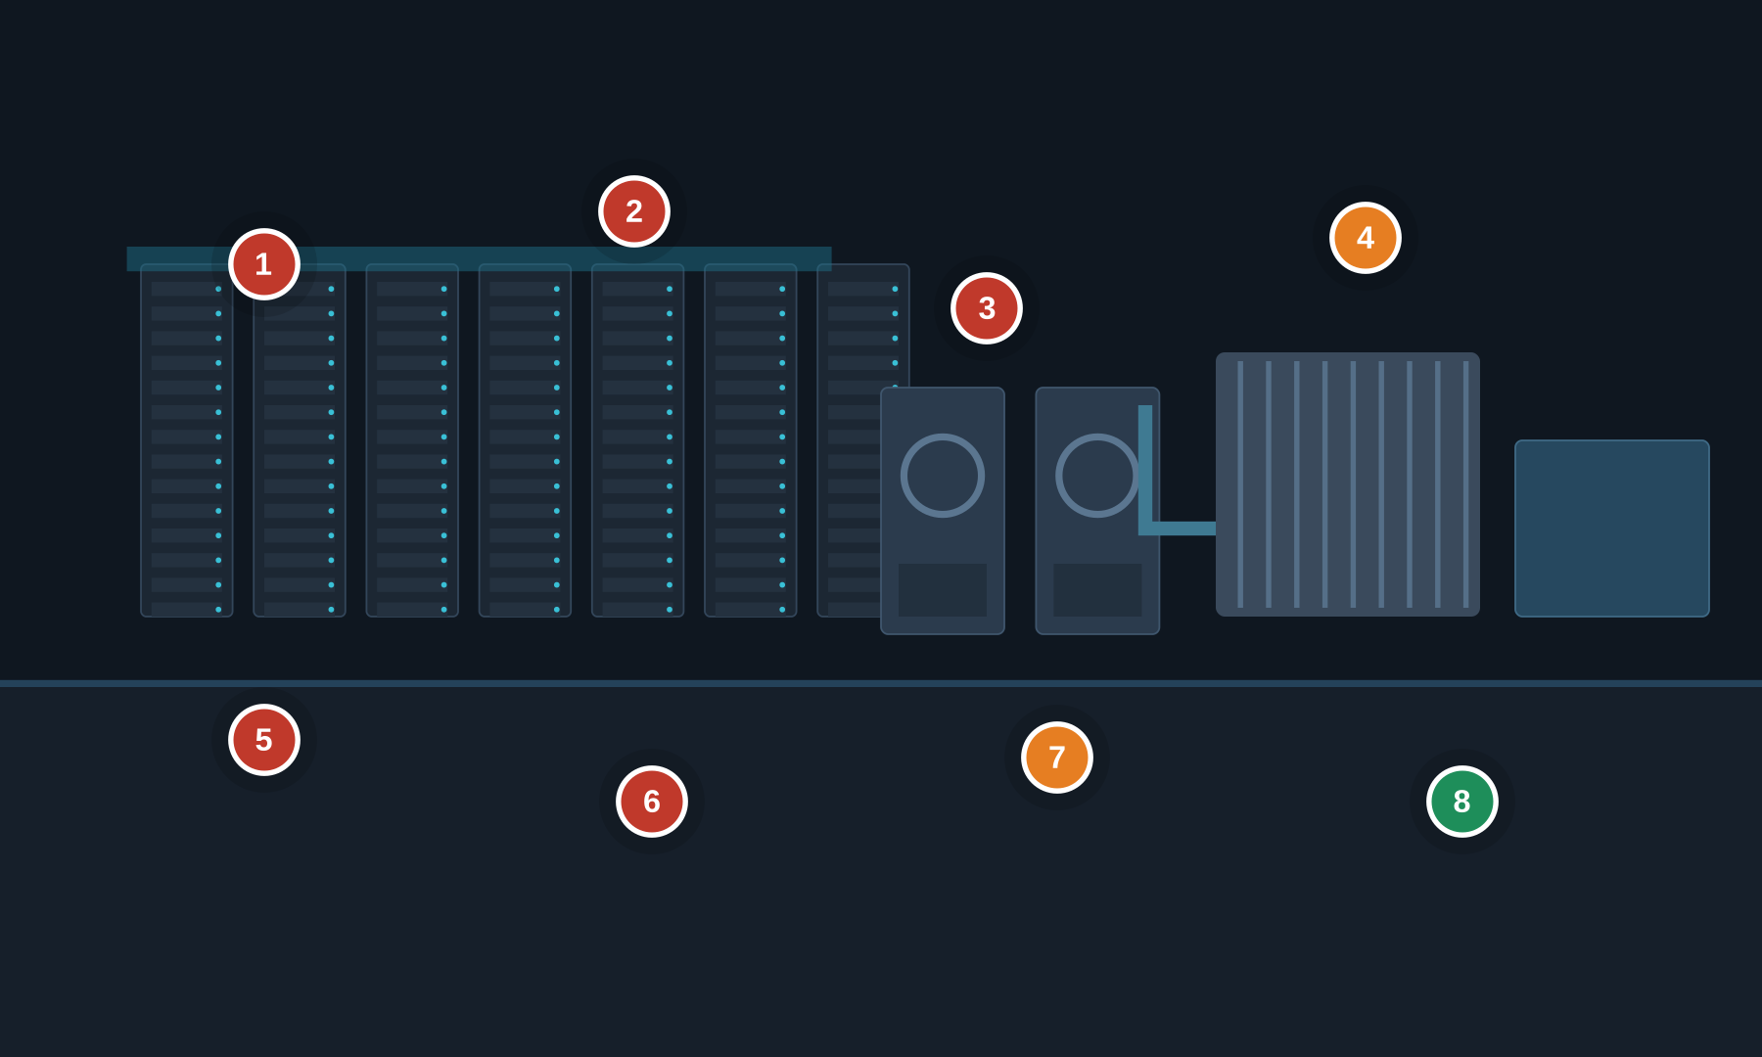
BUILDINGS & FACILITIES
5 cyber
2 safety
1 good
Data Center — Cooling & Mechanical Plant
Critical cooling — chillers, CRAH/CRAC, modular cooling, BMS/BACnet, cold-aisle containment
● cyber ● safety ● good practice Numbered markers = planted findings. Answer key on the next slide.
Notes:
Setting: A data center mechanical plant keeps the white space within temperature. Water-cooled chillers, cooling towers and pumps feed CRAH/CRAC units and containerized/modular cooling; a Building Management System (BMS/BAS) on BACnet/Modbus drives setpoints and sequencing. Loss of cooling is both an availability and an equipment-safety event.
Key OT/IoT assets: Water-cooled chiller plant, CRAH / CRAC units, Modular / containerized cooling units, Cooling tower & condenser pumps, BMS/BAS DDC controllers (BACnet/Modbus), BMS server / operator workstation
People & roles: Critical-environment / facilities operator, BMS / controls engineer, Mechanical technician, Chiller OEM (remote support), Data center manager
Processes: Cooling control & setpoints, Chiller sequencing & staging, BMS alarming & trending, Vendor remote maintenance, Change control (MOC)

Slide 26
BUILDINGS & FACILITIES
Data Center — Cooling & Mechanical Plant — what to look for
1. Flat BMS/BACnet network Cyber
3-3 SR 5.1 Network segmentation
3-3 SR 5.2 Zone boundary protection
4-2 CR 5.1 Network segmentation
5. Shared BMS login Cyber
3-3 SR 1.1 Human user identification and authentication
3-3 SR 1.3 Account management
3-3 SR 1.5 Authenticator management
2. Unauthenticated BACnet writes Cyber
3-3 SR 3.1 Communication integrity
3-3 SR 1.2 Software process and device identification and authentication
3-3 SR 3.5 Input validation
6. Default modular-cooling creds Cyber
3-3 SR 1.5 Authenticator management
3-3 SR 1.7 Strength of password-based authentication
3-3 SR 7.7 Least functionality
3. Always-on chiller OEM access Cyber
3-3 SR 1.13 Access via untrusted networks
3-3 SR 1.5 Authenticator management
3-3 SR 2.6 Remote session termination
7. Failover logic not validated Safety
PLC #7 Validate and alert for paired inputs / outputs
PLC #11 Instrument for plausibility checks
3-3 SR 7.1 Denial of service protection
4. Chiller trip bypassed Safety
84.09 Operation Bypass / override management for the safety function
PLC #2 Track operating modes
PLC #12 Validate inputs based on physical plausibility
8. Segmented, monitored BMS Good practice
3-3 SR 5.2 Zone boundary protection
3-3 SR 6.2 Continuous monitoring
3-3 SR 7.6 Network and security configuration settings

Slide 27
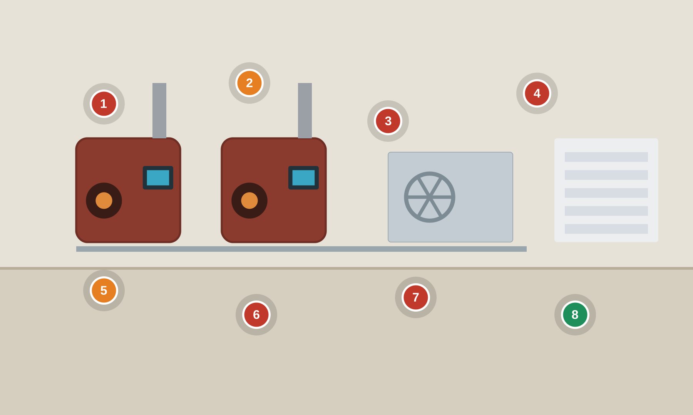
BUILDINGS & FACILITIES
5 cyber
2 safety
1 good
Buildings — Automation & Boiler Plant
Central plant — BAS/BACnet, AHUs, hot-water/steam boilers, burner management (flame safeguard)
● cyber ● safety ● good practice Numbered markers = planted findings. Answer key on the next slide.
Notes:
Setting: A commercial building / campus central plant. A Building Automation System (BAS) on BACnet/LonWorks drives air handlers and VAV boxes; hot-water or steam boilers are protected by a burner management system (flame safeguard) and low-water cutoff — a combustion safety function (per NFPA 85 / ASME CSD-1) that a cyber event must not defeat.
Key OT/IoT assets: BAS supervisory controllers + DDC, Air handling units & VAV boxes, Hot-water / steam boilers, Burner management / flame safeguard, Building controls server, BACnet / LonWorks / Modbus field bus
People & roles: Building engineer / operator, Controls / BAS integrator, Boiler technician, OEM burner vendor, Facilities manager
Processes: HVAC scheduling & setpoints, Boiler sequencing & combustion safety, BAS trending & alarms, Integrator remote support, Change control (MOC)

Slide 28
BUILDINGS & FACILITIES
Buildings — Automation & Boiler Plant — what to look for
1. BAS exposed to internet Cyber
3-3 SR 1.13 Access via untrusted networks
3-3 SR 1.5 Authenticator management
3-3 SR 5.2 Zone boundary protection
5. Combustion alarms inhibited Safety
PLC #20 Trap false negatives and false positives for critical alerts
PLC #7 Validate and alert for paired inputs / outputs
3-3 SR 6.2 Continuous monitoring
2. Burner safeguard forced Safety
84.09 Operation Bypass / override management for the safety function
PLC #15 Define a safe process state in case of a PLC restart
PLC #2 Track operating modes
6. Flat tenant/IT network Cyber
3-3 SR 5.1 Network segmentation
3-3 SR 5.2 Zone boundary protection
4-2 CR 5.1 Network segmentation
3. Integrator laptop across sites Cyber
3-3 SR 2.3 Use control for portable and mobile devices
3-3 SR 3.2 Malicious code protection
4-2 CR 2.13 Use of physical diagnostic and test interfaces
7. No controller backup/inventory Cyber
3-3 SR 7.3 Control system backup
3-3 SR 7.8 Control system component inventory
3-3 SR 7.4 Control system recovery and reconstitution
4. Spoofable BACnet commands Cyber
3-3 SR 1.2 Software process and device identification and authentication
3-3 SR 3.1 Communication integrity
3-3 SR 3.5 Input validation
8. Independent burner management Good practice
84.09 Operation Management of change (MOC) for the safety function
3-3 SR 2.1 Authorization enforcement
4-2 EDR 3.11 Physical tamper resistance and detection

Slide 29
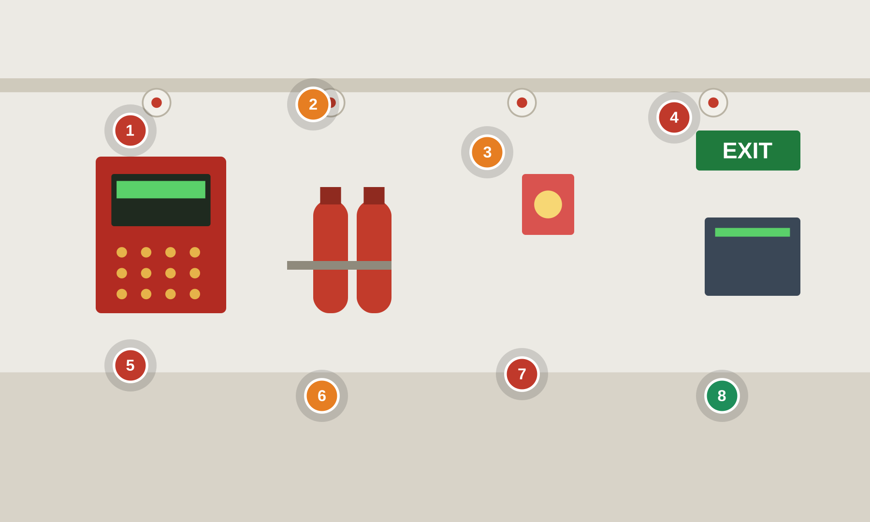
BUILDINGS & FACILITIES
4 cyber
3 safety
1 good
Buildings — Fire & Life Safety Systems
FACP, suppression release, smoke control, mass notification — increasingly IP-networked
● cyber ● safety ● good practice Numbered markers = planted findings. Answer key on the next slide.
Notes:
Setting: A building fire & life safety installation. A fire alarm control panel (FACP) with addressable detectors drives alarm and evacuation; suppression release (pre-action / clean-agent) and smoke-control HVAC are safety functions; mass notification / voice evacuation warns occupants. These follow NFPA 72 / life-safety codes — the flags below are the cyber overlay on top of that governance, not a replacement for it.
Key OT/IoT assets: Fire alarm control panel (FACP), Suppression release panel (pre-action / clean-agent), Smoke-control (HVAC interface), Mass notification / voice evacuation, IP fire-alarm gateway, Emergency generator / ATS interface
People & roles: Fire safety director, Life-safety / fire-alarm technician, BAS integrator, Authority Having Jurisdiction (AHJ), Security operations
Processes: Detection & alarm, Suppression release logic, Smoke-control sequencing, Mass notification, Testing / inspection & MOC

Slide 30
BUILDINGS & FACILITIES
Buildings — Fire & Life Safety Systems — what to look for
1. FACP on IT network Cyber
3-3 SR 5.1 Network segmentation
3-3 SR 5.2 Zone boundary protection
4-2 NDR 5.2 Zone boundary protection
5. Mass-notification reachable Cyber
3-3 SR 1.2 Software process and device identification and authentication
3-3 SR 2.1 Authorization enforcement
3-3 SR 5.2 Zone boundary protection
2. Suppression release bypassed Safety
84.09 Operation Bypass / override management for the safety function
PLC #2 Track operating modes
3-3 SR 2.1 Authorization enforcement
6. Zones left disabled Safety
PLC #20 Trap false negatives and false positives for critical alerts
PLC #2 Track operating modes
3-3 SR 6.2 Continuous monitoring
3. Smoke-control spoofable Safety
3-3 SR 3.1 Communication integrity
3-3 SR 3.5 Input validation
PLC #7 Validate and alert for paired inputs / outputs
7. No change control on panel Cyber
3-3 SR 2.8 Auditable events
3-3 SR 2.12 Non-repudiation
84.09 Operation Management of change (MOC) for the safety function
4. Plaintext fire gateway Cyber
3-3 SR 1.5 Authenticator management
3-3 SR 3.1 Communication integrity
3-3 SR 4.3 Use of cryptography
8. Segmented life-safety net Good practice
84.09 Operation Management of change (MOC) for the safety function
3-3 SR 5.2 Zone boundary protection
3-3 SR 6.2 Continuous monitoring

Slide 31
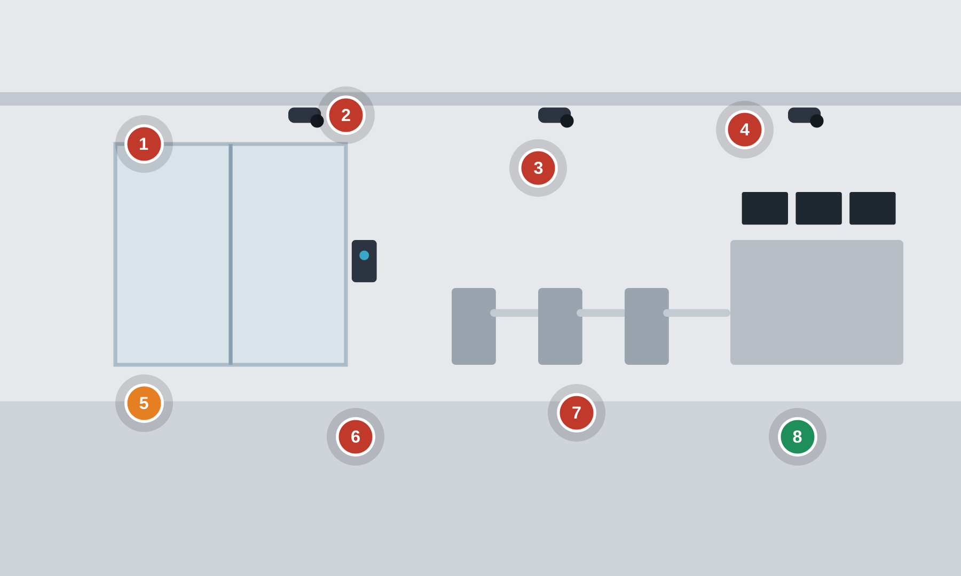
BUILDINGS & FACILITIES
6 cyber
1 safety
1 good
Buildings — Physical Access Control & Security
PACS — IP door controllers, card readers (Wiegand/OSDP), CCTV/VMS, intrusion, elevator/turnstiles
● cyber ● safety ● good practice Numbered markers = planted findings. Answer key on the next slide.
Notes:
Setting: A physical security system for a building or critical site. A Physical Access Control System (PACS) with IP door controllers and card readers governs badge access and electric locks; CCTV cameras feed a VMS/NVR; intrusion detection, turnstiles/mantraps and elevator access round it out. PACS is the cyber-physical gateway to substations, data-center white space and control rooms.
Key OT/IoT assets: PACS door controllers, Card / badge readers (Wiegand / OSDP), CCTV cameras & VMS / NVR, Intrusion detection panel, Turnstiles / mantrap & elevator control, Access control server + directory
People & roles: Physical security manager, Security operations center (SOC) operator, PACS / CCTV integrator, Facilities, Employees & visitors
Processes: Badge access & authorization, Video surveillance & retention, Alarm monitoring & response, Visitor management, Credential lifecycle

Slide 32
BUILDINGS & FACILITIES
Buildings — Physical Access Control & Security — what to look for
1. Cleartext Wiegand readers Cyber
3-3 SR 3.1 Communication integrity
3-3 SR 4.3 Use of cryptography
3-3 SR 1.2 Software process and device identification and authentication
5. Unlock override enabled Safety
PLC #2 Track operating modes
PLC #15 Define a safe process state in case of a PLC restart
3-3 SR 2.1 Authorization enforcement
2. Default-cred IP cameras Cyber
3-3 SR 1.5 Authenticator management
3-3 SR 5.2 Zone boundary protection
3-3 SR 1.13 Access via untrusted networks
6. Unpatched, tamperable devices Cyber
4-2 EDR 3.11 Physical tamper resistance and detection
4-2 EDR 3.10 Support for updates
4-2 CR 2.13 Use of physical diagnostic and test interfaces
3. Flat door-controller net Cyber
3-3 SR 5.1 Network segmentation
3-3 SR 5.2 Zone boundary protection
4-2 CR 5.1 Network segmentation
7. Always-on VMS/PACS access Cyber
3-3 SR 1.13 Access via untrusted networks
3-3 SR 1.5 Authenticator management
3-3 SR 2.6 Remote session termination
4. Shared PACS admin, no audit Cyber
3-3 SR 1.1 Human user identification and authentication
3-3 SR 2.8 Auditable events
3-3 SR 2.12 Non-repudiation
8. OSDP-secure, segmented, logged Good practice
3-3 SR 3.1 Communication integrity
3-3 SR 2.8 Auditable events
4-2 EDR 3.14 Integrity of the boot process

Slide 33
Build from this catalog
A reusable base of ICS/OT/IoT cyber-physical scenarios. Add sectors, swap in your own assets and photoreal scenes, and extend the standards flags.
15
120
4
6
scenarios
flagged findings
standards mapped
sectors
Finding types and standard mappings are teaching aids, not a compliance assessment. Confirm ISA-TR84.00.09 v3 clause numbers against your controlled copy.

